Slide 1
Sabotage Stockton Center for International Law U.S. Naval War College
May 2024
Unclassified
Notes:
Introductions

Slide 2
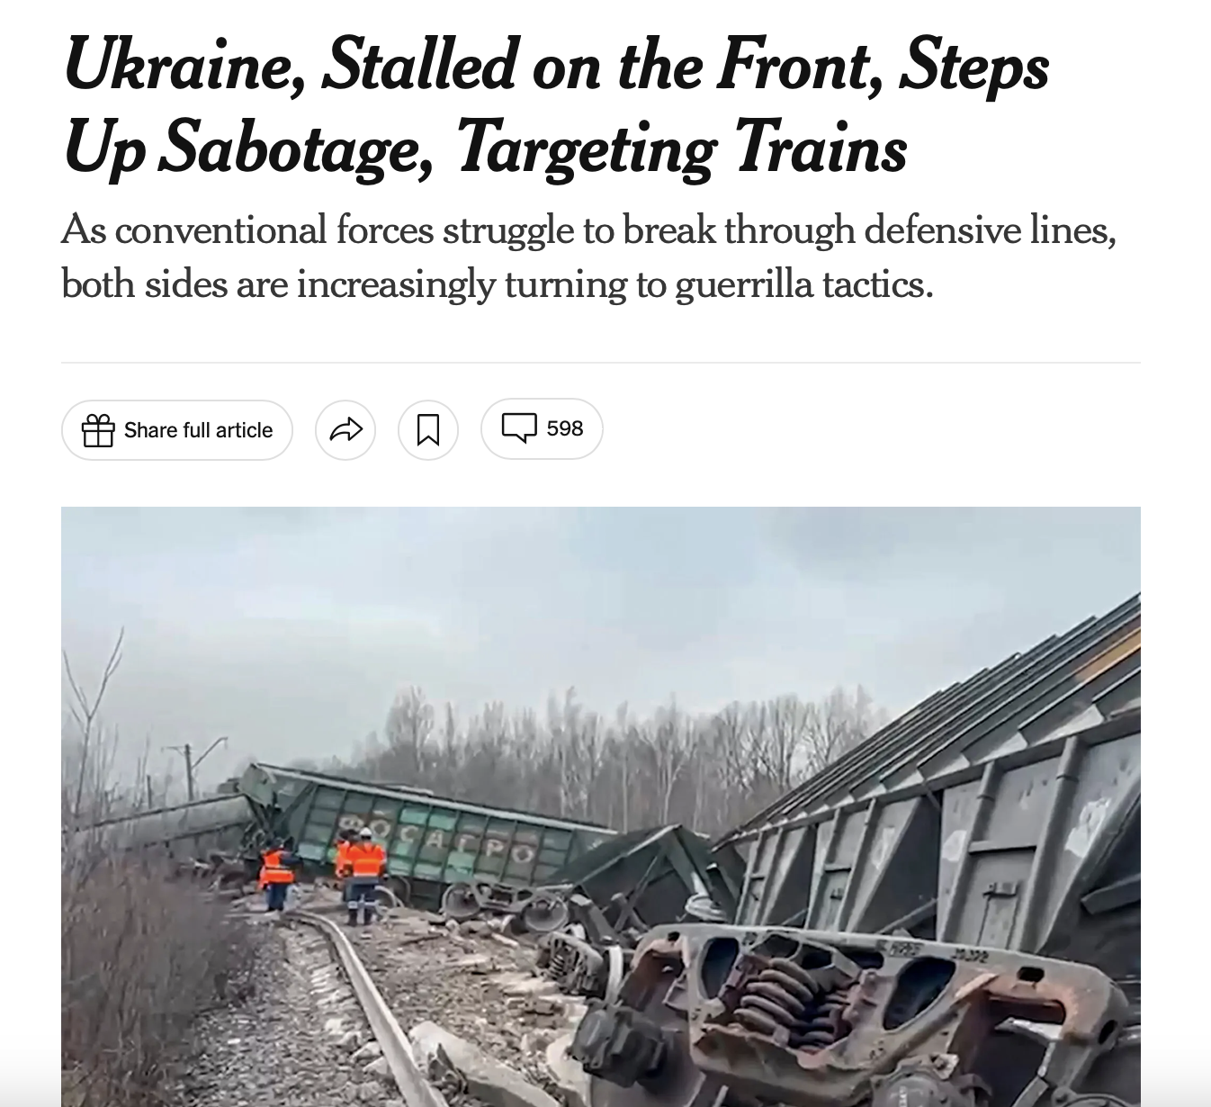
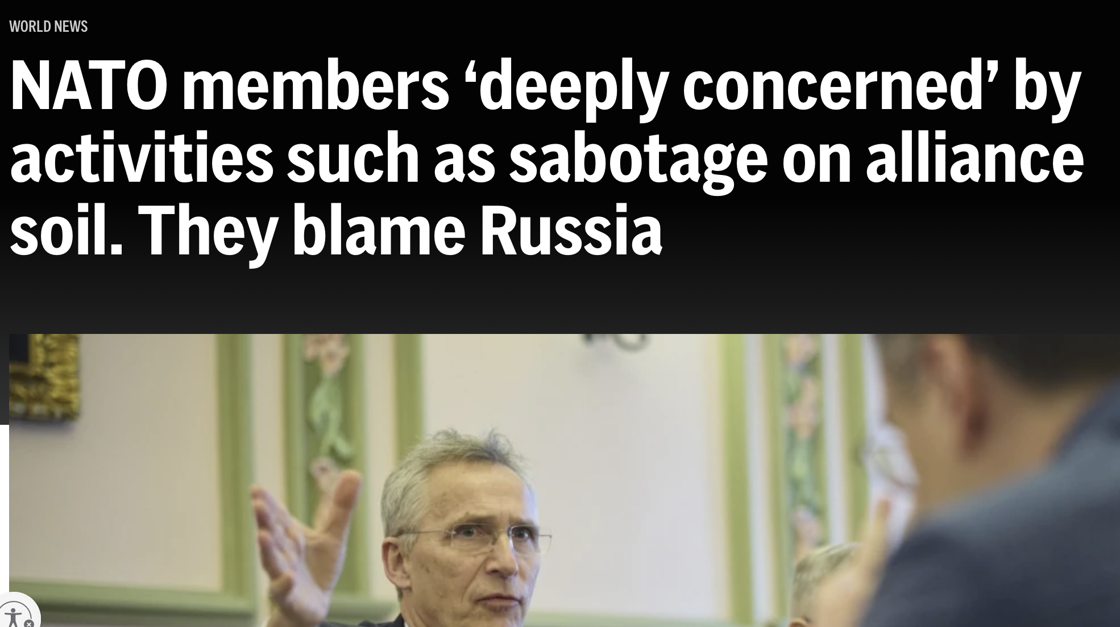
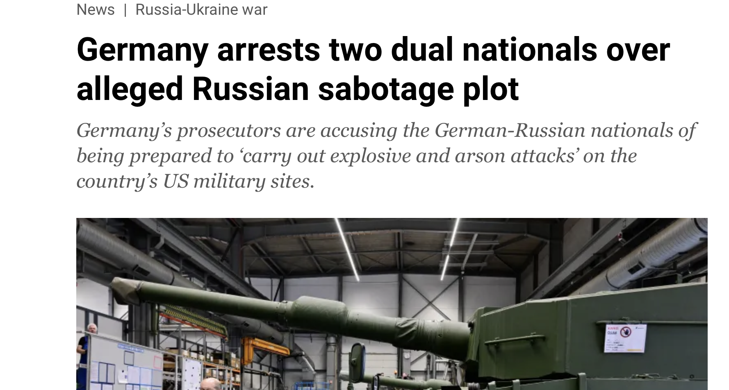
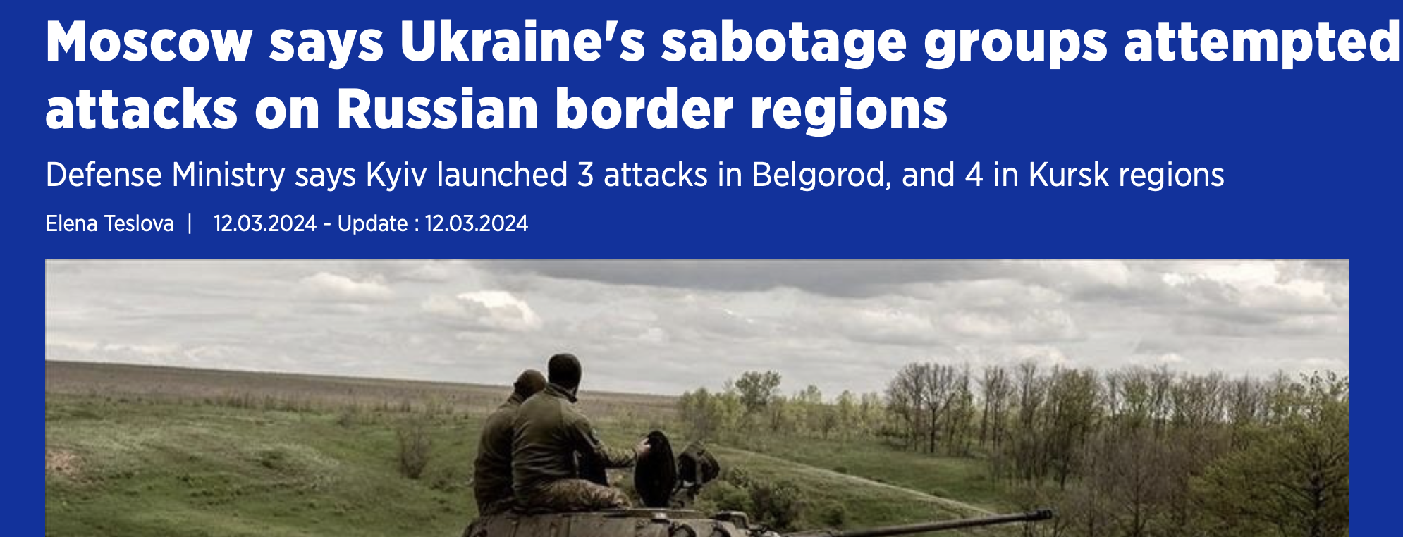
Sabotage

Slide 3
What is Sabotage?
Not defined in international law
Not necessarily defined in military doctrine
ICRC definition: “Action taken to destroy or damage material, works or installations which by their nature or purpose add to the efficiency of the enemy’s armed forces.”
Another definition: “Clandestine, hostile acts that are typically (but not exclusively) performed behind enemy lines and with the intent to harm the enemy’s war effort.”
Generally: Primary intent is to damage or destroy military objects.

Slide 4
Not unlawful per se
Not specifically prohibited by treaty or customary international law
Lawfulness depends on:
Category of person(s) conducting activity
Military
Civilian
Target
Military objective
Civilian object
Means and methods used

Slide 5
Risks
Physical Risk
Saboteurs assume great physical risk
Military commanders will attempt to mitigate physical risk to the maximum extent possible
IHL Risk
Means used - Mines, time delayed explosives, etc.
Feasible precautions
Proportionality
Methods used - Wear of uniforms
Distinction
Perfidy

Slide 6
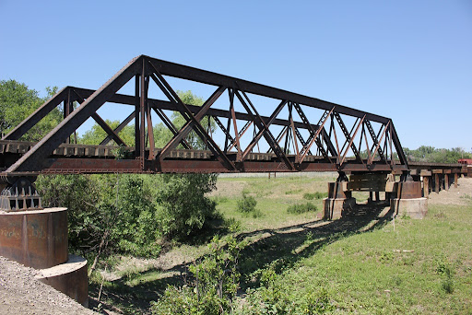
IHL Risks

Slide 7
Precautions
Use of mines or time delayed explosives
Precautions in attack
Additional Protocol I, Art. 57(2)(a)(ii)
take all feasible precautions in the choice of means and methods of attack with a view to avoiding, and in any event to minimizing, incidental loss of civilian life, injury to civilians and damage to civilian objects;

Slide 8
Proportionality
Use of mines or time delayed explosives
Proportionality
Additional Protocol I, Art. 51(5)(b); Art. 57(2)(a)(iii)
an attack which may be expected to cause incidental loss of civilian life, injury to civilians, damage to civilian objects, or a combination thereof, which would be excessive in relation to the concrete and direct military advantage anticipated.
1) Proportionality analysis based on anticipated collateral damage
2) Uncertainty?

Slide 9
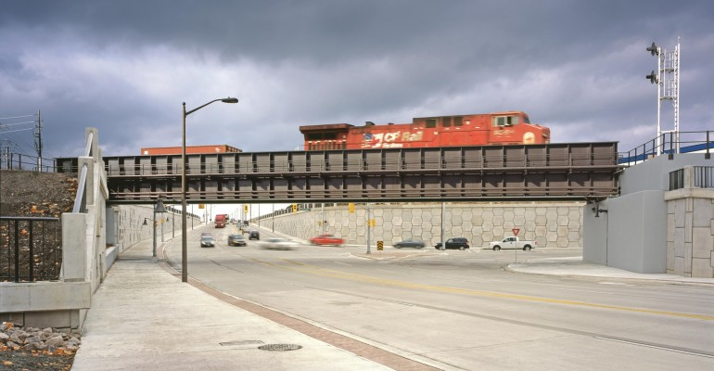
IHL Risks

Slide 10
Distinction
Wear of uniforms
GC III, Art. 4(A)(2)
vs.
Additional Protocol I, Art. 44(3)
Wear of civilian clothes not unlawful but…
Treated as a spy
Hague V, Art. 29
Additional Protocol I, Art. 46
Loss of combatant immunity and POW status if captured in civilian clothes

Slide 11
Perfidy
Article 37 of AP I prohibits the “kill[ing], injur[ing] or captur[ing] an adversary by resort to perfidy.”
Perfidy:
Acts inviting the confidence of an adversary to lead him to believe that he is entitled to, or is obliged to accord, protection under the rules of international law applicable in armed conflict, with intent to betray that confidence . . . [which includes] the feigning of civilian, non-combatant status.”

Slide 12
Questions?

