Slide 1
RUSSIAN WAR OF AGGRESSION AGAINST UKRAINE
LEGAL ASPECTS
Colonel VIKTOR MASLIUK
Chief of International Law Branch
Legal Department of the Ministry of Defense of Ukraine

Slide 2
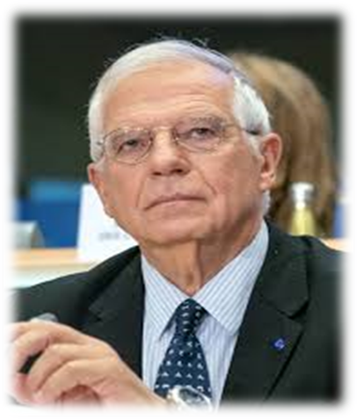
INSTEAD OF FOREWORD
“We have never done it” is not a recipe. Maybe we have to start doing things that we have never done in the past. When we hesitate, we regret it.
EU Ambassadors Annual Conference 2022:
Opening speech by High Representative Josep Borrell

Slide 3
SCOPE
LEGAL DOMAIN
STRATEGIC SYNCHRONIZATION
Lines of action:
EMPOWERING LEGAL EXPERTISE
LEGAL RESILIENCE FOR SECURITY
STRATEGIC LEGAL MESSAGING

Slide 4
LEGAL DOMAIN
Within the context of armed conflict and the mission of the Ukrainian Armed Forces, identifying law’s multi-faceted role as an operating domain as well as a tool that can help achieve desired effects – and as a set of tools that can be used against it – will help enhance state security sector’s resilience and best take advantage of the full range of law’s power to best complement kinetic operations.
Implementation of Ukraine’s sanction policy within the Ministry of Defense of Ukraine
Legal Service
Conduct of legal review of the drafts of the Government Regulations on the application of sanctions
Verify the MOD counteragents on being under sanctions regime to avoid partnership with under-sanctions individuals and legal entities

Slide 5
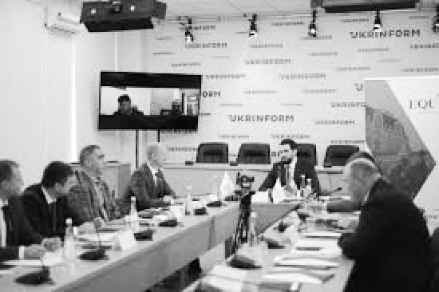
MECHANISM of
application, lifting and amendment of sanctions
1st step
2d step
3d step
4th step
Proposal to apply, lift and amend sanctions is generated by the MOD of Ukraine
Decision to apply, lift and amend sanctions is made by the NSDC
Decision to apply, lift and amend sanctions enters into force by the Decree of the President of Ukraine
Decision to apply, lift and amend sanctions is approved by the Cabinet of Ministers

Slide 6
STRATEGIC SYNCHRONIZATION
Establishing a built in operational and tactical military command mechanism which allows to document and transmit the evidence of the opponent’s breach of law on a very low level of tactical operations to strategic level to expose that type of inferior actions and to inform decision-making process. This mechanism is configured for enhancing synchronization of strategic litigation and national security operations with objective-driven analysis to identify the way of using law to achieve strategic objectives and apply good faith interpretation of international law.
Legal Service
International law violations evidence recording, collection, and referring to the law enforcement agencies, Prosecutor General Office, MOJ, MFA
Preliminary legal review

Slide 7
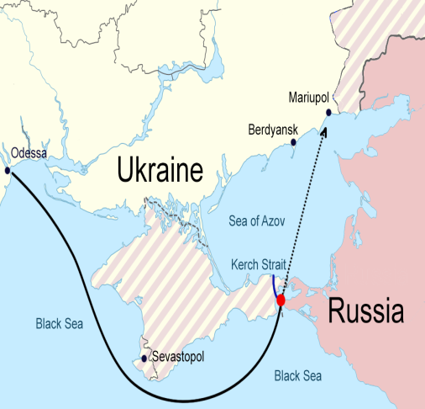
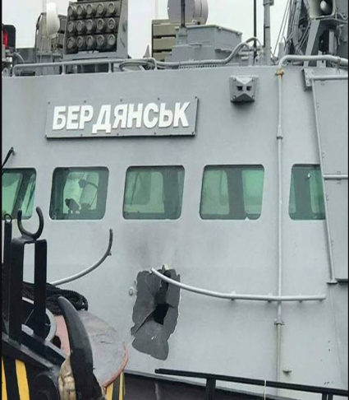
International Tribunal for the law of the sea
Case concerning the detention of three Ukrainian naval vessels
(Ukraine v. Russian Federation), Provisional Measures
Background: Incident that occurred on 25 November 2018 in the Kerch strait, during which the russian federal security service (FSB) coast guard fired upon and captured three Ukrainian navy vessels (the Nikopol, the Berdyansk, the Yani Kapu) and 24 servicemen after they attempted to transit from the Black sea into the Sea of Azov through the strait on their way to the port of Mariupol

Slide 8
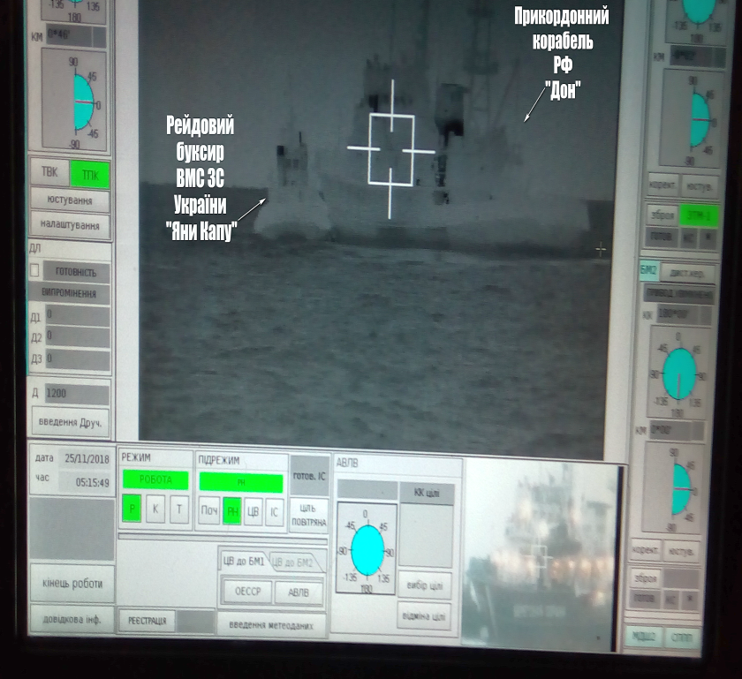
The Role of the Legal Service of The Armed Forces of Ukraine in the Case
Key responsibilities:
advising on the NAVY legal procedures
providing documents and evidences relevant to the case
consulting on the NAVAL battle rhythm nuances
liaising NAVY to MFA regarding the case

Slide 9
MAIN FUNCTIONS OF THE IWG
Military analysis
Crime scene inspection
Supporting OPG & SSU
Geospatial analysis

Slide 10
5 March 2024, International Criminal Court issued warrants of arrest for Russian high -level commanders:
Lieutenant General, the Commander of the Long-Range Aviation of the Aerospace Force, Sergei Kobylash and admiral of the Russian Navy, Commander of the Black Sea Fleet, Viktor Sokolov.

Slide 11
TIME-BASED DISTRIBUTION OF STRIKES ON ENERGY INFRASTRUCTURE

Slide 12
Energy network and strike locations
- The heat map of the strikes entirely coincides with the map of the energy system of Ukraine.
- The campaign's general goal was to destroy Ukraine's energy system as such.

Slide 13
EMPOWERING LEGAL EXPERTISE
Ensuring that national security decision makers empower the legal experts within the system to give good faith interpretations of the law (as an instrument of formulation of the state policy on national defense and security) even though their recommendations do not necessarily alien completely with the policy objective that the policy makers have.
Legal Service
Recommendations to the political and military leadership on application of the national and international law (examples: cluster munitions and avoiding allocation of military objectives within or near densely populated arears)
formulation of policy papers on “IHL and Cyber” and “AI”

Slide 14
RECOMMENDATIONS TO THE POLITICAL AND MILITARY LEADERSHIP ON APPLICATION OF THE NATIONAL AND INTERNATIONAL LAW
- Rules on the application of cluster munitions;
- Rules and recommendations on the capturing process and treatment of POWs;
- Recommendations on avoiding allocation of military objectives in densely populated areas;
- etc.
etc.

Slide 15
DEVELOPMENT OF POLICY PAPERS ON IHL IN CYBER AND AI WARFARE
- Development of policy recommendations on the applicability of IHL to cyber operations
- Ensuring IHL compliance of weapons utilizing AI technology
- Policy papers and recommendations are based on the information acquired from the field
- Reliance on expert capacities of lawyers from the commanding units working directly with the questions addressed

Slide 16
LEGAL RESILIENCE FOR SECURITY
Improving application of legal instruments to build legal resilience and strengthen national security and defense sector by utilizing effectively existing legal tools to achieve particular effects in the national and international security arena
Legal Service
IHL implementation, compliance, and dissemination
Voluntary report on the domestic implementation of IHL
Establishment and conducting a legal review mechanism to fulfill obligations under article 36 of the PA I
Legal review and implementation of International treaties on the security guarantees for Ukraine
Implementation of Acquis EU into Ukrainian legislature
Shaping a legal framework for defense procurement reform

Slide 17
LEGAL RESILIENCE - 6 MONTHS SPRINT
DRAFTED
19
DRAFT LAW
38
PRESIDENTIAL DECREE
114
GOVERNMENT DECREE
LEGAL EXPERTISE
114
DRAFT LAW
792
REGULATORY ACT
15
INTERNATIONAL AGREEMENTS
ISSUED
610
MOD ORDER
45
REGISTERED IN MJ

Slide 18
IHL DISSEMINATION
PURPOSE
RESULTS
To ensure
- Ukrainian needs in IHL trainings are addressed
- IHL modules are included in all relevant trainings
- Training materials for IHL modules are standardized
- Lessons learnt and best practies of the russian-Ukrainian AC on IHL implementation are incorporated
- during more than 2 years under EUMAM and SAG-U umbrella trainings as part of the military assistance have been provided
- more than 450 trainings are provided by Partner States to the AFU

Slide 19
IHL COURSES DETAILS
- Practical tools of IHL modules in all trainings are developed
- Consent of Partner States on developed tools is achieved

Slide 20
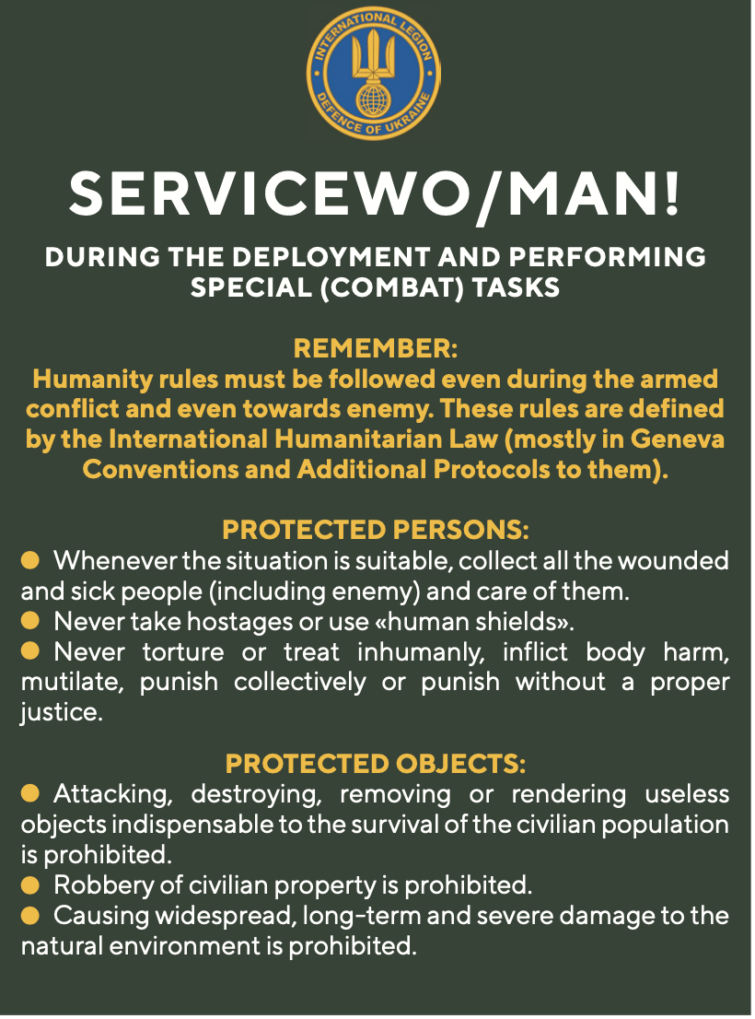
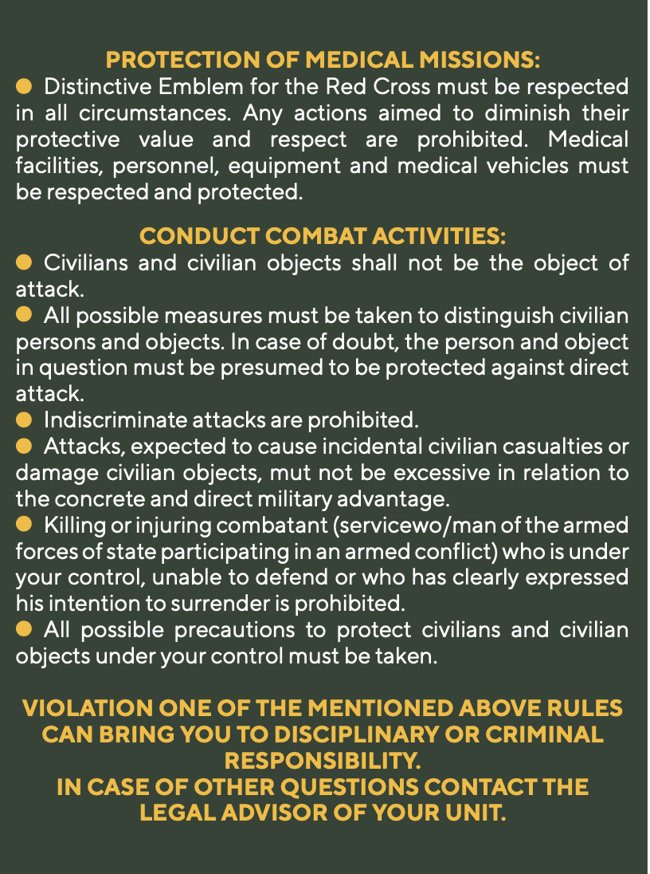
SOLDIER CARD ON BASIC IHL

Slide 21
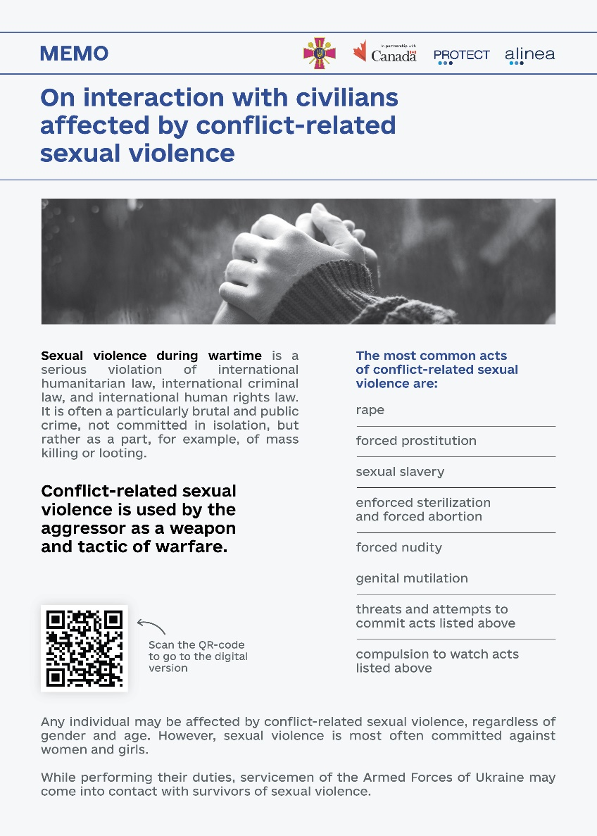
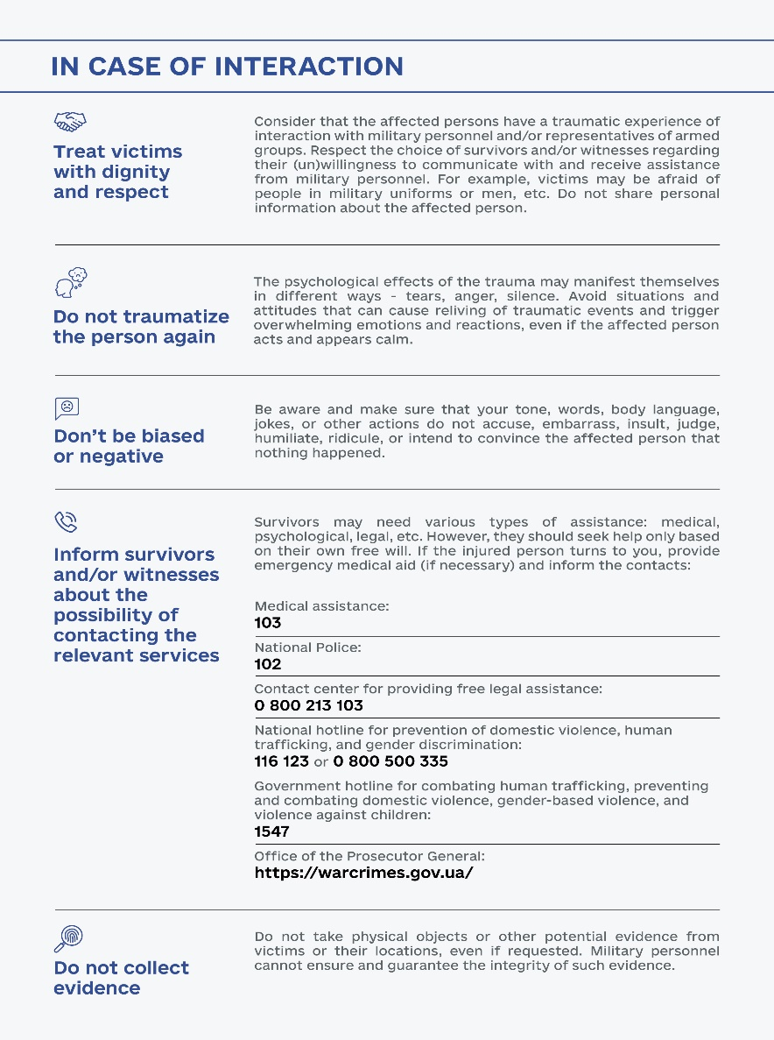
SOLDIER CARD ON INTERACTION

Slide 22
VOLUNTARY REPORT ON THE DOMESTIC IMPLEMENTATION OF INTERNATIONAL HUMANITARIAN LAW
Sharing best practices on implementing IHL among the international community
Ensuring that national legislation complies with IHL norms
Identifying areas requiring further action

Slide 23
MECHANISM OF LEGAL REVIEW OF
NEW WEAPONS
Duty to determine whether a new weapon would be prohibited under IHL
(Article 36 of PA I)
- A comprehensive legal review mechanism will be incorporated into the weapons acquisition process
- The mechanism will be based on a unified review algorithm addressing express conventional and customary restrictions and limitations, general principles of IHL, as well as dictates of humanity and public conscience
- The review will be conducted by a team consisting of lawyers, weapons specialists, and medics
Щone

Slide 24
LEGAL REVIEW AND IMPLEMENTATION OF BILATERAL AGREEMENTS ON SECURITY GUARANTEES FOR UKRAINE
Legal department conducted legal analysis of 9 bilateral agreements on the security guarantees for Ukraine
(United Kingdom of Great Britain and Northern Ireland, Federal Republic of Germany, French Republic, Denmark, Canada, Italian Republic, Netherlands, Republic of Finland and Latvia)

Slide 25
IMPLEMENTATION OF ACQUIS EU INTO
UKRAINIAN LEGISLATURE
Association Agreement
On 1 September 2017, the Association Agreement between Ukraine and the European Union, the European Atomic Energy Community and their Member States entered into force.
Main objective: adaptation of Ukrainian legislation to EU acquis
Implementation into national legislation
Drafting the Law of Ukraine "On Defence Procurement": Harmonisation with Directive 2009/81/EC, in line with the Association Agreement
Establishment of the Ministry for Strategic Industries
Upcoming steps
Submission to the Verkhovna Rada of Ukraine of a draft law on approval of the National Programme for the Adaptation of Ukrainian Legislation to EU acquis
Cooperation with the Office for Coordination of European and Euro-Atlantic Integration of the Cabinet of Ministers of Ukraine and other stakeholders
Implementation process
Self-screening process launched to assess the state of implementation of EU acquis
MoD conducted legal expertise of 6 EU acquis

Slide 26
SHAPING A LEGAL FRAMEWORK FOR DEFENSE PROCUREMENT REFORM
Legal advice (expertise) on the NATO-Ukraine Strategic Defence Procurement Review as part of the Comprehensive Assistance Package for Ukraine
legal expertise and acting as a co-chair of the first working group, whose subject of expertise is defence procurement in the context of national security governance
providing clarification on the problems that hinder the functioning and sustainable development of the defence procurement system
clarification on the Ukrainian legislation, as well as the purpose, main provisions and expected results of the implementation of the legislation in the field of defence procurement
Providing proposals on how to solve problematic issues in the defence procurement system by amending the regulations

Slide 27
STRATEGIC LEGAL MESSAGING
Facilitation of legal compliance on tactical and operational levels by establishing strategic messaging mechanism to inform domestic and international audience on the state compliance with the law and to identify the attempts of the opponent to distort the public perception of legitimacy.
Legal Service
Communication strategy on IHL
Information campaigns on enemy’s IHL violations
Disseminating information via official web-page of the Ministry of Defence

Slide 28
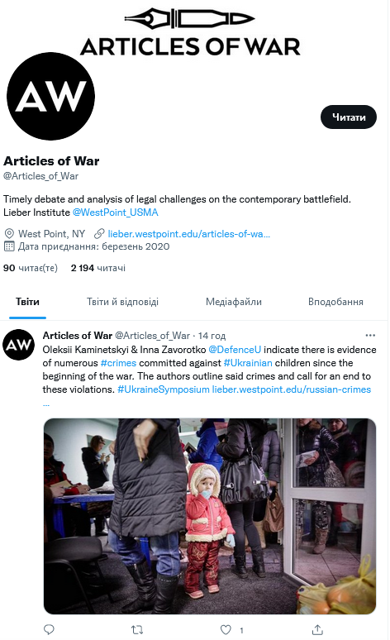
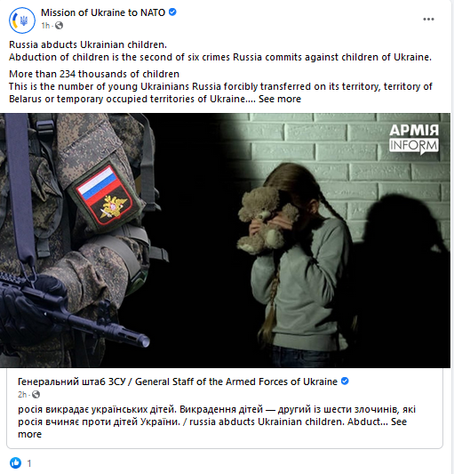
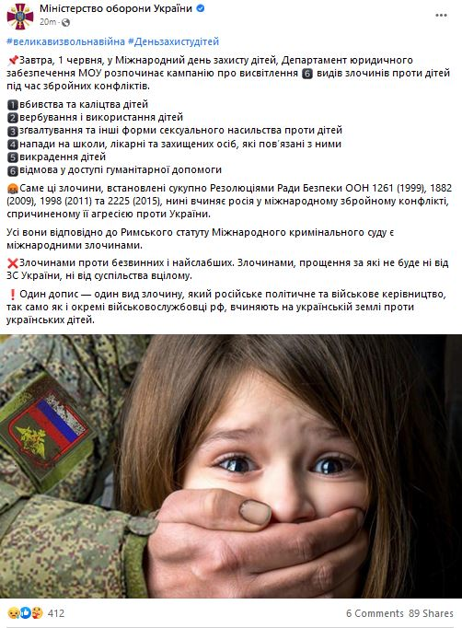
PLANS AND HOLDS IHL INFORMATIONAL LEGAL CAMPAIGNS

Slide 29
“In war, the chief incalculable is the human will”
Sir Basil Henry Liddell Hart

Slide 30
QUESTIONS?
Ministry of Defense of Ukraine
Armed Forces of Ukraine
State Transport Special Service

