Slide 1
.
UKRAINE: EVIDENTIAL & PROCEDURAL CHALLENGES
Brigadier (Retd) James Johnston (UK)
> Council of Europe Expert Advisory Group to the Prosecutor General of Ukraine
> Personal Capacity / Chatham House Rules
> War Crimes Stats:
1) OVER 128,062 ONGOING RUSSIAN WAR CRIMES INVESTIGATIONS
2) FEB 24: UKRAINE HAS IDENTIFIED 511 WAR CRIMINALS AND CONVICTED 81 OF THEM
3) THE VAST MAJORITY (70+) CONVICTED IN ABSENTIA
> Content:
1) Adducing OSINT/EV
2) Conduct of Trials in absentia

Slide 2
OPEN-SOURCE INTEL/EV (OSINT)
> WHAT IS IT & HOW USED:
Information publicly available,
Often digital & acquired via Internet,
Social media content, satellite imagery, Maps, Weather, flight tracking, etc etc
> APPLICATION TO WAR CRIMES INVESTIGATIONS:
War Crimes Inv Characteristics: No Access, Ev Destroyed, No Witnesses, No Suspects
Increased reliance on open-source digital evidence:
2017/18 ICC -v- Al-Werfalli Arrest Warrants -Social Media videos of extra judicial killings

Slide 3
OPEN-SOURCE INTEL/EV (OSINT) - CHALLENGES & STRATEGY’S:
1) Abundant Sources of OSINT/Ev
Emails - 241,000,000 Per Min
WhatsApp messages - 41,600,000 Per Min
Facebook Posts - 4,000,000 Per Min
Instagram Reels - 694,000 Per Min
X (Twitter) Posts - 360,000 Per Min
YouTube Videos uploaded - 500 hours Per Min
> Looking for a Needle in a Haystack:
AI (Inc Machine Learning)
Expanded Investigatory Networks: NGO’s, Journalists, Citizen Investigators
Investigatory Teams include computer programmers and data scientists

Slide 4
OPEN-SOURCE INTEL/EV (OSINT) - CHALLENGES & STRATEGY’S:
2) Wide Range of “Investigators” = Inconsistent Collection Standards:
Archiving
Original Source (Metadata) and Continuity
Contamination (watermarks, soundtracks)
Objectivity
> The Berkeley Protocol on Digital Open-Source Investigations (Berkeley Human Rights Centre + Office of the High Commissioner for Human Rights)
Internationally accepted Protocol: Comprehensive, Best practice
Allows consistent verification procedures of evidence for Prosecutors/Judges
Adoption limits evidence admissibility challenges

Slide 5
OPEN-SOURCE INTEL/EV (OSINT) - CHALLENGES & STRATEGY’S:
3) Authenticity Challenge: Case Example - Ukraine and The Netherlands -v- Russia (ECHR 8019/16, 43800/14 and 28525/20)
Russian HR violations in Occupied Eastern Ukraine (inc MH17 Buk Missile)
Ukraine evidence included research and articles compiled by Bellingcat on Russian cross-border artillery attacks in eastern Ukraine
Bellingcat Ev demonstrated geolocation, placing the soldier + unit at Pavloka Training Camp near the Ukrainian border, the site of artillery strikes into eastern Ukraine in 2014.
Russia allege Ukraine Bellingcat Ev is manipulated and fake

Slide 6
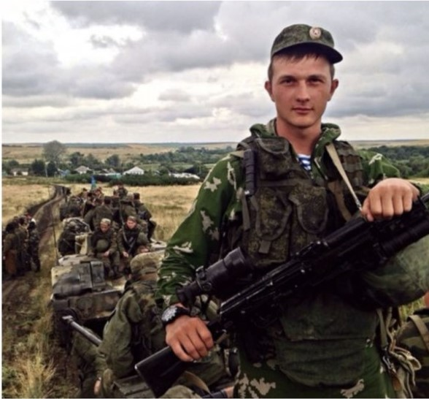
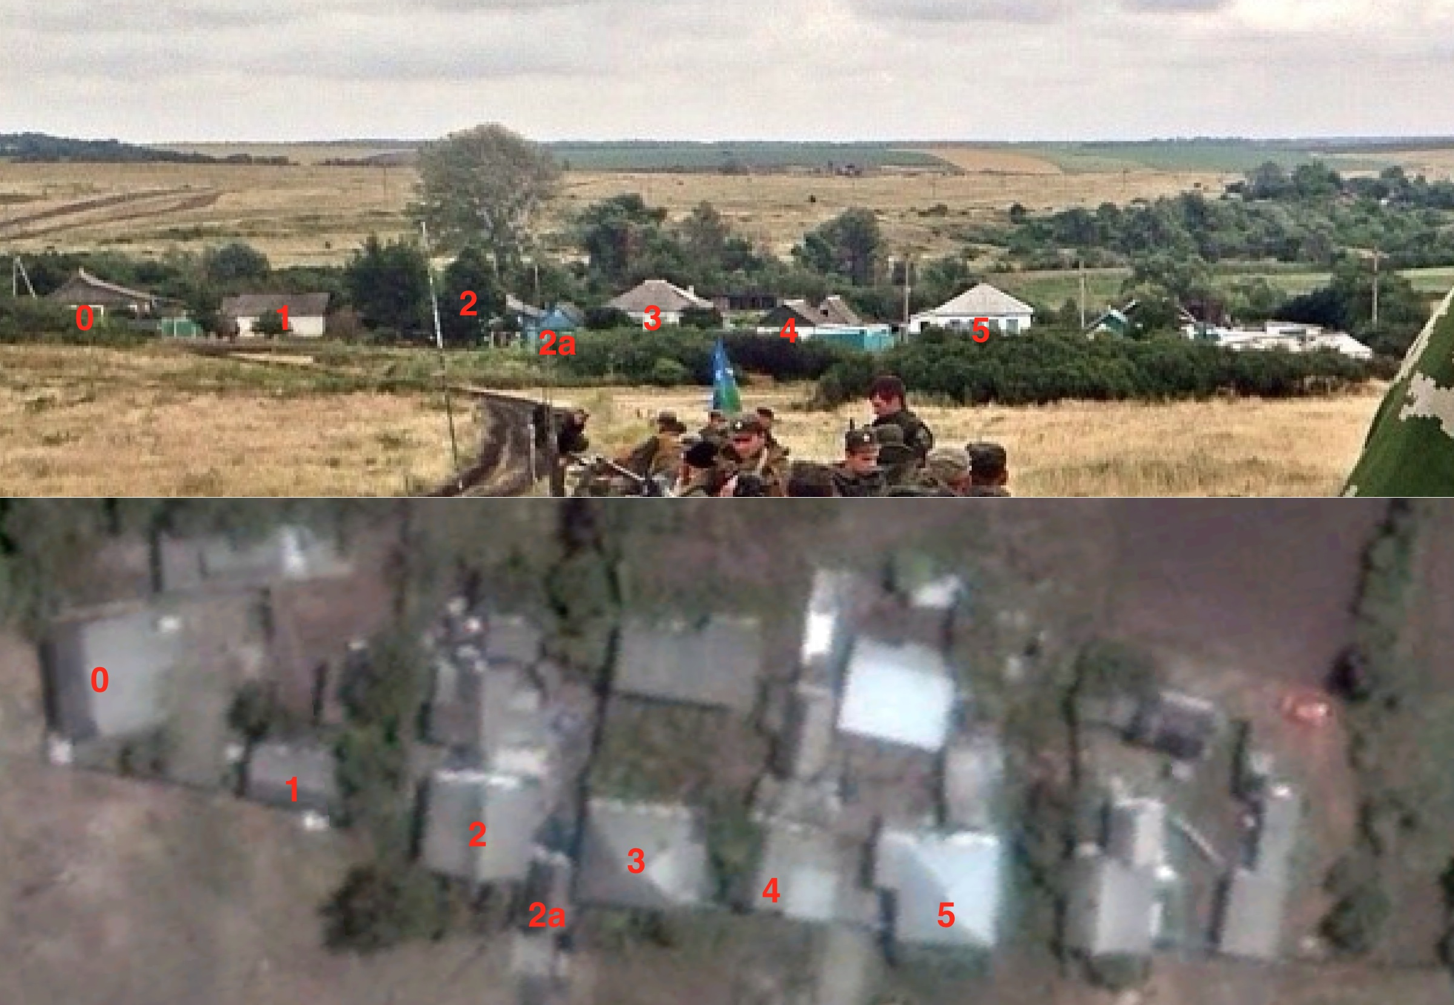
Ukraine: Bellingcat Evidence
Google Earth used to match roofs, path, & crop patterns to Geolocate Phot to Pavloka Camp

Slide 7
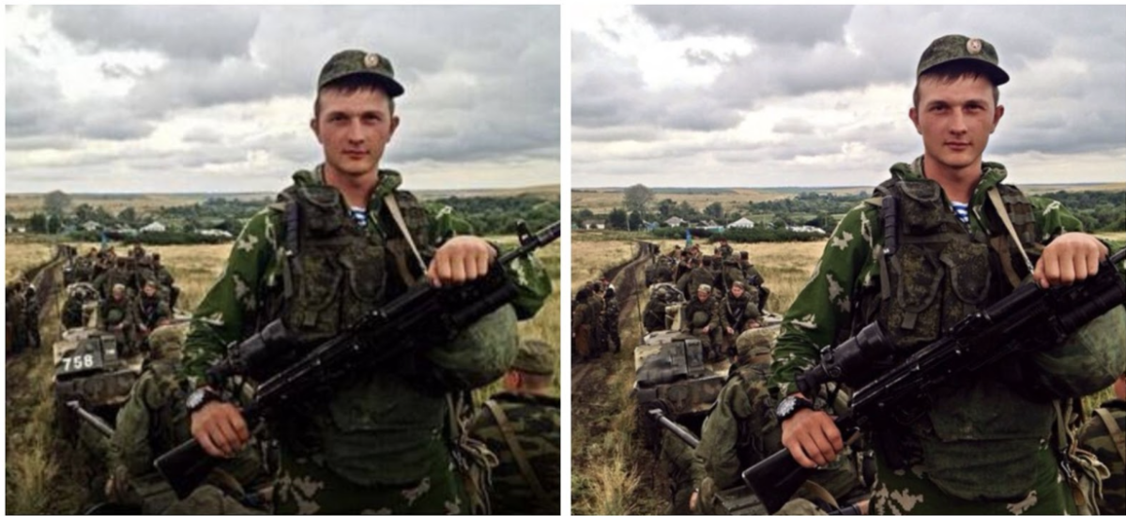
Atlantic Council Think Tank - August 2014 , Bellingcat: December 2014
SPOT THE DIFFERENCE!

Slide 8
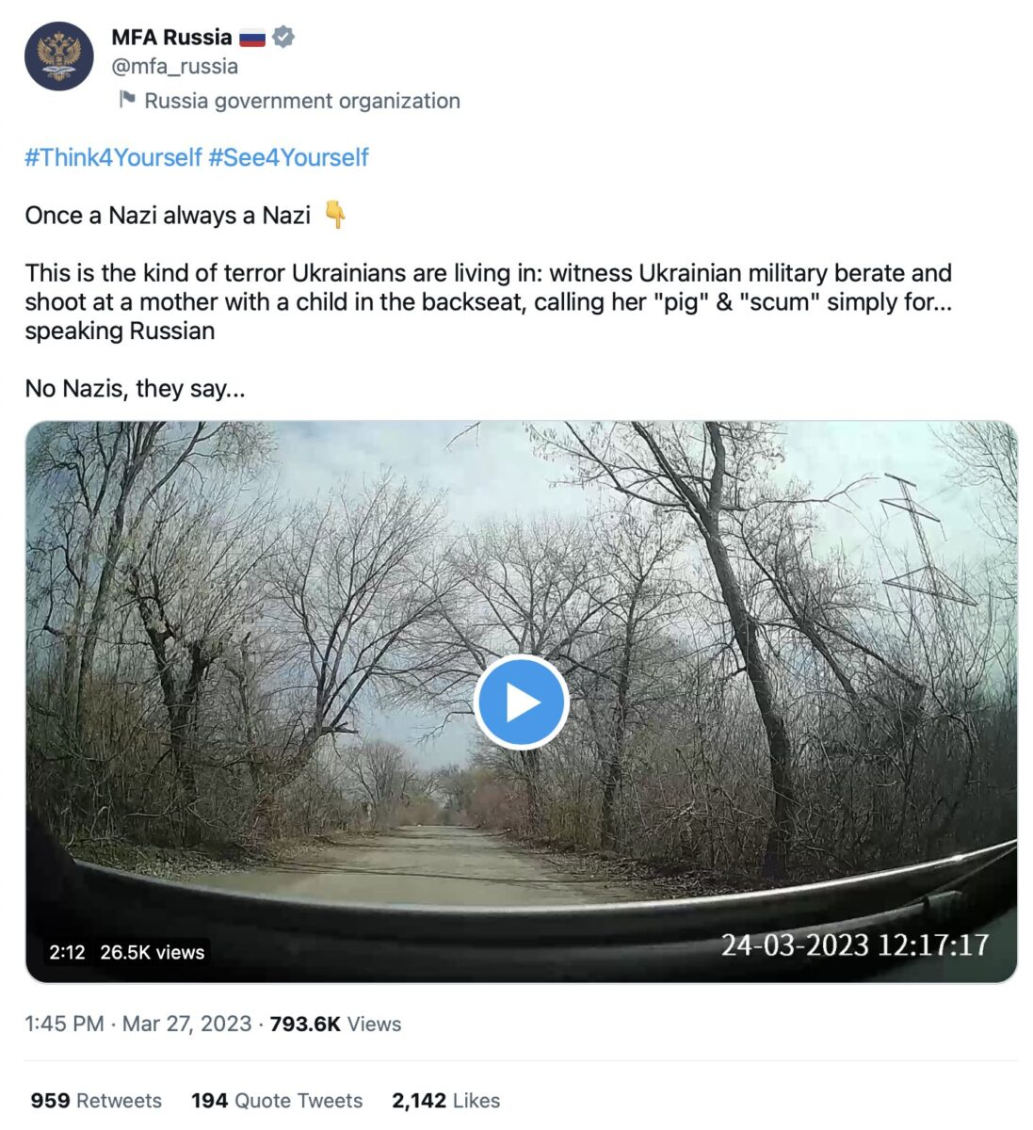
3) Deep Fake: Case Example:
> Dashcam of Ukraine Soldiers harassing
Russian speaking woman on 24 Mar 23
> Circulated by Pro-Russian activists: “Once a
Nazi, always a Nazi”
> Geolocation: 30k behind Russian lines
Strategies for Deep Fakes
>1) Verify Source: Known?, Photos, Phone, Docs
> 2 Prove Content: Triangulate
- Metadata -v- Location, Time, Weather
- Geolocation
AI: Reverse imaging, frame defects, Eyes/Heart
Testimony

Slide 9
Trials In Absentia (TIA): BACKGROUND
> 1945: Nuremburg: Martin Bormann
> 1948: Universal Declaration of Human Rights, 1953: ECHR, 1966: ICCPR : All guarantee:
- Public hearings
- Right of accused to know and understand allegations he faces
- Right of accused to examine the evidence and question witnesses
- Accused access to legal representation / interpreter
> 1994: International Criminal Tribunal for the Former Yugoslavia:
- Rule 61: Witness evidence given before accused arrested
> 2002: International Criminal Court:
- Art 61(2)b: Pre-Trial Chamber can confirm charges for trial in absentia if Accused fled
- Art 63(1): “…The accused shall be present during the trial…”
> 2009: Special Tribunal for Lebanon: Inefficient, Ineffective and Expensive

Slide 10
Trials In Absentia (TIA): KEY PRINCIPLES
> Accused presence at trial is fundamental to a Fair Trial So TIA will contravene Art 6 ECHR / ICCPR Fair Trial Unless:
1) IS ACCUSED AWARE OF PROCEEDINGS?
> Court must demonstrate “All Reasonable Steps” taken to summons Accused
> Untraceable not sufficient [Colozza v. Italy, 12 February 1985, A no. 89]
2) HAS ACCUSED WAIVED RIGHT TO TRIAL or EVADED JUSTICE
> Acc Waiver not valid where obligations arise from military service [F.C.B. v. Italy, judgment of 28 August 1991, Series A no. 208-B] .
> Burden on the authorities to prove Accused was seeking to evade justice not the Accused
IF A TIA DEEMED LAWFUL: [Accused Aware and Waived Right Or Evaded Justice]
> Accused Must be represented by Defence Counsel in his absence
> Accused TIA Must have a Right of Appeal
BUT>>>>>>>>>>>>>>>>>>>>

Slide 11
Trials In Absentia (TIA): KEY PRINCIPLES
> SUBSEQUENT RE-TRIAL A STRONG POSSIBILITY, ESPECIALLY FOR WAR CRIMES:
Sanader v. Croatia, no. 66408/12, 12 February 2015:
“…A retrial is considered obligatory in the case of a conviction in absentia of war crimes when the authorities are unable to notify an accused of the proceedings or to secure her/his presence. The accused should not have to surrender in order to benefit from the right to a retrial…”
- The accused should not have to surrender to his/her sentence in order to benefit from the right to a retrial…”
RE-TRIAL PROCEDURE
> All original evidence to be examined in adversarial proceedings in the presence of an accused (Idalov v. Russia ([GC], no. 5826/03, 22 May 2012)
> Accused entitled to examine the witnesses testifying in the re-opened proceedings + Authorities expected to secure the presence of a witness. (Palchik v. Ukraine, no. 16980/06, 2 March 2017)
> SO ARE TRIALS IN ABSENTIA WORTHWHILE???

